Slide 1
Machine Learning Approaches for advanced Industrial Applications
Allmin Pradhap Singh Susaiyah
Scientist, Philips Research, Eindhoven, Netherlands
Marie Curie Fellow

Slide 2
Contents
Focus:
in-depth exposure to ML approaches for advanced industrial applications will be provided.
Much focus will be on ML approaches on Images with a brief overview of other applications. The talks will have three sessions as listed below. Prior knowledge on ML or python is not required. Basic programing skills on any language will be helpful but not mandatory.
Phase1:
Session1 - (18th Nov, 11:30AM to 1:00PM): Python Basics
Session2 - (18th Nov, 2:00 PM to 4:00PM): Traditional Machine Learning and Deep Learning
Session3 - (20th Nov, 2:00 PM to 4:00PM): Image Classification using Deep Learning
Phase2:
Session1- (9th Dec, 11:30AM to 1:00PM): Python Basics
Session2- (9th Dec, 2:00 PM to 4:00PM): Traditional Machine Learning and Deep Learning
Session3- (11th Dec, 2:00 PM to 4:00PM): Image Classification using Deep Learning
Phase3:
Session1- (6th Jan, 11:30AM to 1:00PM): Python Basics
Session2- (6th Jan, 2:00 PM to 4:00PM): Traditional Machine Learning and Deep Learning
Session3- (8th Jan, 2:00 PM to 4:00PM): Image Classification using Deep Learning

Slide 3
Session1 Machine Learning and Python in Industry

Slide 4
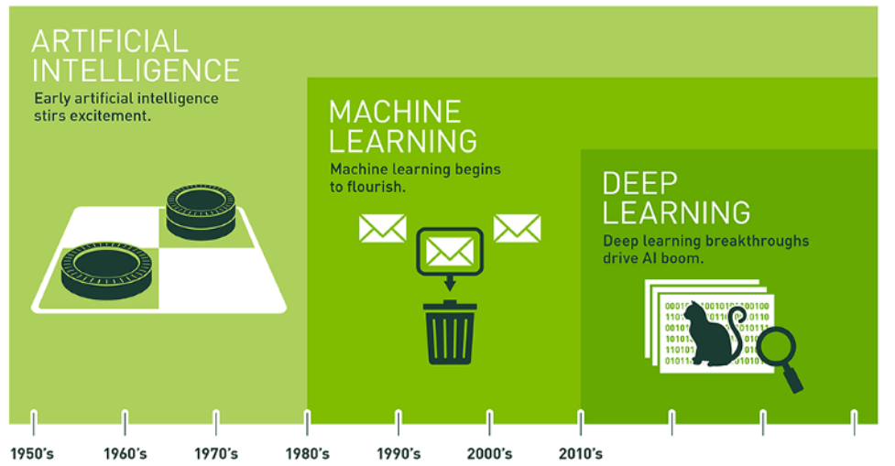
Artificial Intelligence and its evolution

Slide 5
ML in Industries..
There isn’t a field where the knowledge of AI cannot be utilized for
Healthcare
The focus of Artificial intelligence is more on empowering physicians rather than replacing them
Looking at the medical AI ecosystem, we can see that much of the work is going on in Prediction and prevention, wellness, aging, rehabilitation and technological augmentation of doctors.
AI and ML are also helping in medical imaging, Drug discovery, Medication management and robotic surgery.
Research
Ability to discover new drug, GENOME information
Mobility
Driverless vehicles
Navigation
Daily Activities
Voice Agents
Spam Filters
Business
Chat-bots
Insights

Slide 6
Why Phython
Easy to understand and write code
Open Source
Freely available libraries for most scientific applications

Slide 7
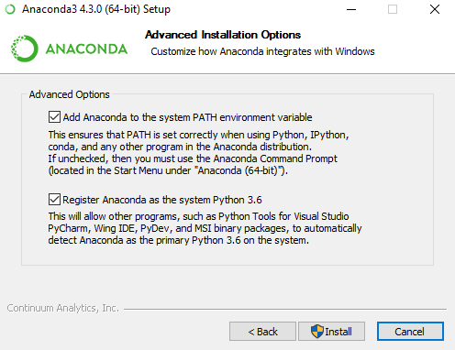
Installing Anaconda
Log into a windows 64 bit system as admin
Install and open gitbash from https://git-scm.com/download/win
cd C:/
Git clone https://github.com/allmin/mlworkshop.git
Download
https://repo.continuum.io/archive/Anaconda3-4.3.0-Windows-x86_64.exe
Navigate to the Anaconda3-4.3.0-Windows-x86_64.exe installer
Right click and run as administrator
Click yes on the prompt
Click Next -> I Agree -> All Users -> C:\Anaconda3-> Next
Make sure both check boxes are ticked
Click Install

Slide 8
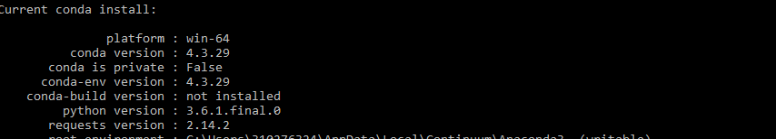
Testing if installation was successful
Open command prompt (winkey + R, type cmd, return)
type
conda info
You must get a list of conda information like below
If you get it, your Anaconda installation was successful!!

Slide 9
Opening Workshop Materials
Open jupyter notebook by using following command
cd C:/mlworkshop
jupyter-notebook
Web browser opens with a webpage
Click on Python Basics.ipynb

Slide 10
Now Lets Get into the Code..

Slide 11
Session2- Traditional Machine Learning and Deep Learning

Slide 12
ML Practices
Parse data
learn from it
make a determination or prediction about something in the world
SUPERVISED LEARNING:
Data + Labels
UNSUPERVISED LEARNING:
Data Only

Slide 13
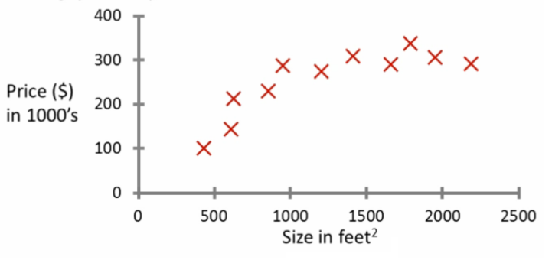
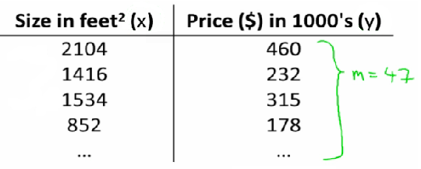




Supervised Algorithm 1
Linear Regression

Slide 14
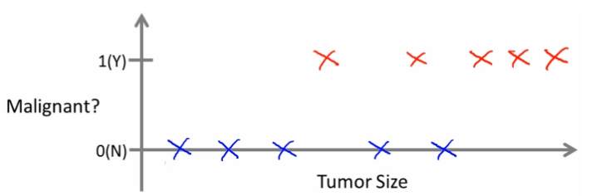
Supervised Algorithm 2
Logistic Regression
h_{θ}(x) = g((θ^{T} x))
g(z) = 1/(1 + e^{-z})

Slide 15
ML JARGON
Feature set:
Input Data
Labels, Ground Truth, Annotation :
Target Data
Classifier, Regression :
An algorithm used for learning predicting whether the given sample is class A, B or …..
Dimensionality Reduction:
If too many features, we derive fewer features from original feature set
Feature Selection:
If too many feature, we ignore irrelevant or insignificant features
Overfitting or Biased:
This is when you learn something too specific to your data set and therefore fail to generalize well to unseen data
Under fitting or regularized:
Opposite of overfitting

Slide 16
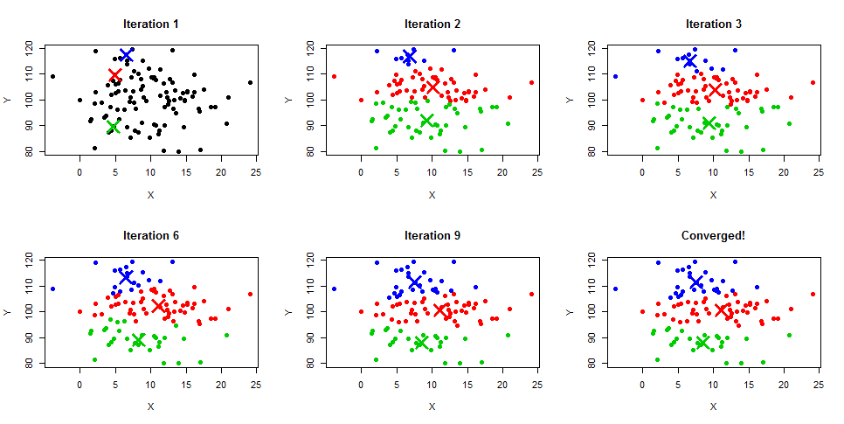
Unsupervised Algorithm – K Means
Data Driven
No Labels
Iterative
process

Slide 17
COMMON ML Techniques
SVM : Support Vector Machine
RF : Random Forest
ANN : Artificial Neural Networks

Slide 18
BASIC IMPLEMENTATION OF ML IN PYTHON
import numpy as np
X = np.array([[-1, -1], [-2, -1], [1, 1], [2, 1]])
y = np.array([1, 1, 2, 2])
from sklearn.svm import SVC
clf = SVC()
clf.fit(X, y)
print(clf.predict([[-0.8, -1]]))
print(clf.predict([[0.8, 1]]))

Slide 19
Feature Selection
Genetic Algorithm
Information Gain
Feature Reduction
Principal Component Analysis

Slide 20
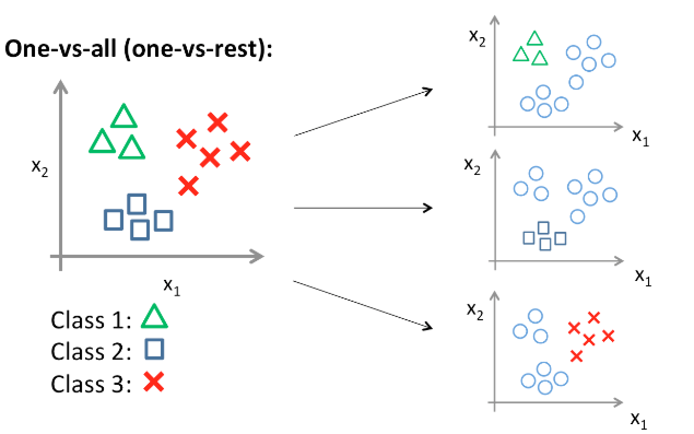
One Versus All Classification

Slide 21
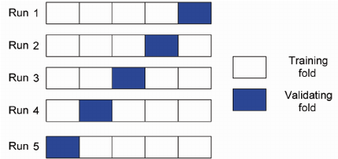
Cross Validation
%split (80 - 20 split)
K - Fold Cross Validation (5 fold)

Slide 22
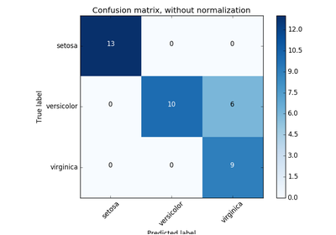
Confusion Matrix

Slide 23
Now Lets Get into the Code..

Slide 24
Session3 – Image Classification using Deep learning

Slide 25
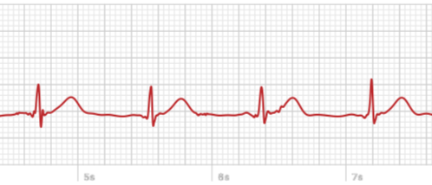
Signal Processing
Signal
Function that "conveys information about the behaviour or attributes of some phenomenon“
Y = f(x)
X is independent, Y is dependent
Ex: ECG signal:
- time is independent variable
- lead potential is dependent variable
Can you name a few signals?

Slide 26
Signal Processing
Science that concerns the analysis, synthesis, and modification of signals
Analysis:
ECG analysis: HR detection, anomalies
IMU analysis: fall detection
Synthesis:
Voice signals are synthesized for communication via mobile phones
Music signal conditioning
Modification
Amplifiers
Modulation AM/FM

Slide 27
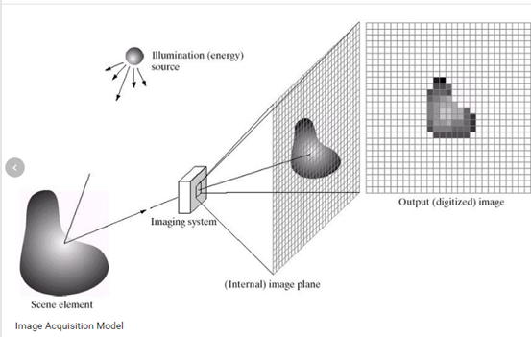
Image Processing
What is an Image and How Image is formed?

Slide 28
Contd..
Image is a 2 dimensional signal
Independent variables are space! (f(x,y))
Image Processing is the Analysis, Synthesis and Modification of Images
Analysis
Medical Imaging Scans CT, MRI
Synthesis
Heat map generation
Difference detection
Modification - Basic operations on Images
Image enhancement – removing noise and sharpening an image
Image segmentation – isolating objects of interest and gathering statistics
Image registration – aligning multiple images from different camera sources

Slide 29
Now Lets Get into the Code..

